Slide 1
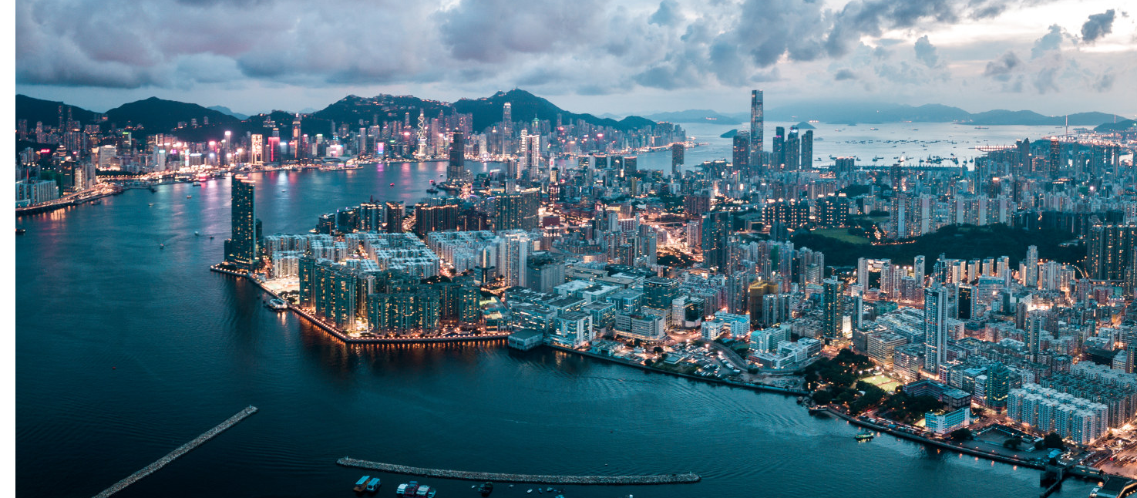
HK Weather Data Set Presentation
Weather can make the same place look very different at different times. Climate tells us what kinds of weather usually happen in an area at different times of the year.
Gloria Chan & Anson Leung
\

Slide 2
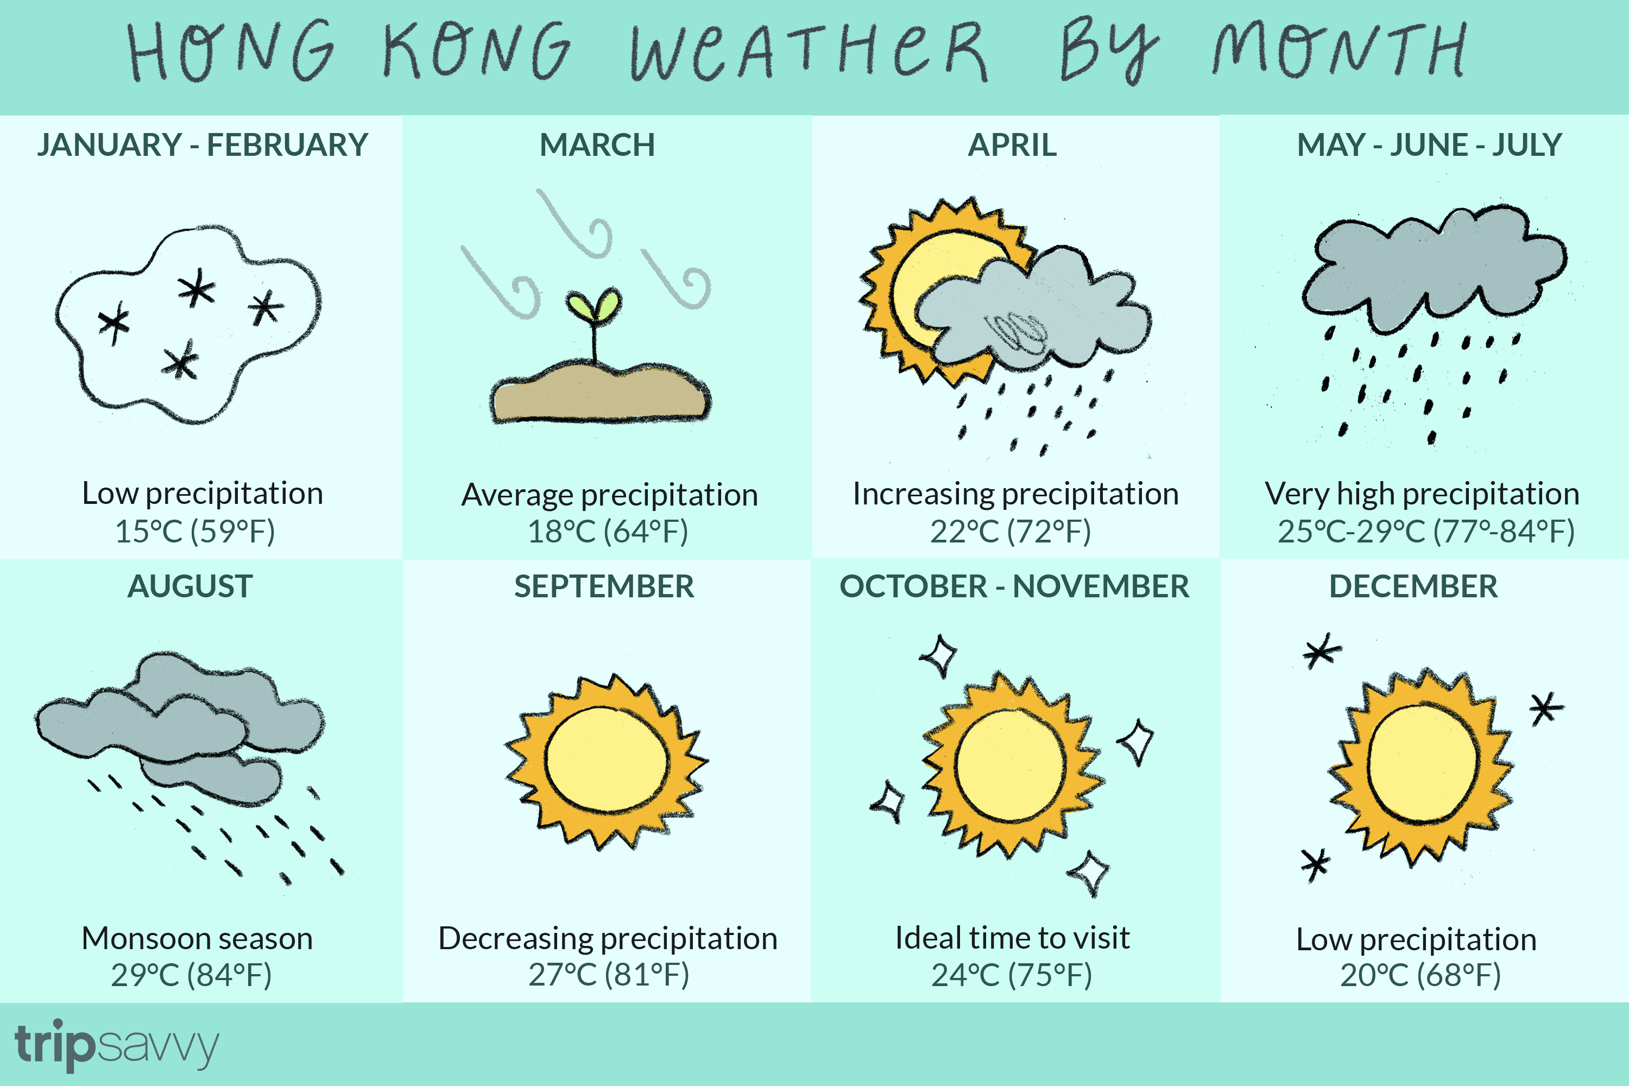

Slide 3
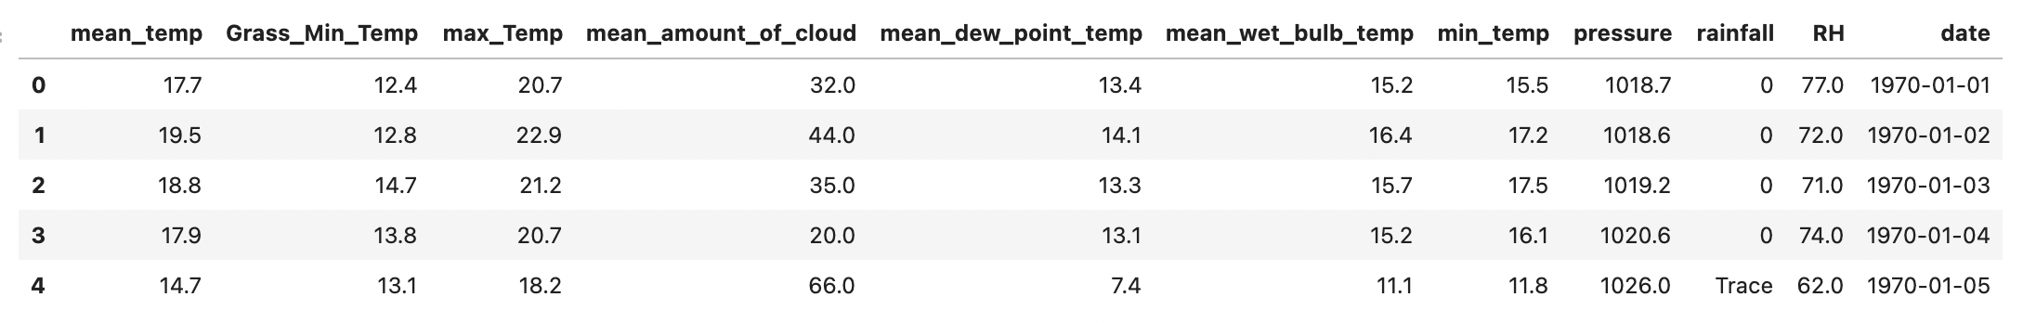
Data Set Introduction
Weather Record from HK Observatory from 1970 - 2019
18262 entry in total: https://www.kaggle.com/hindy51/hong-kong-weather-20082016
Major weather indicators
Temperature
Rainfall
Pressure
What can we derive from the weather pattern?

Slide 4
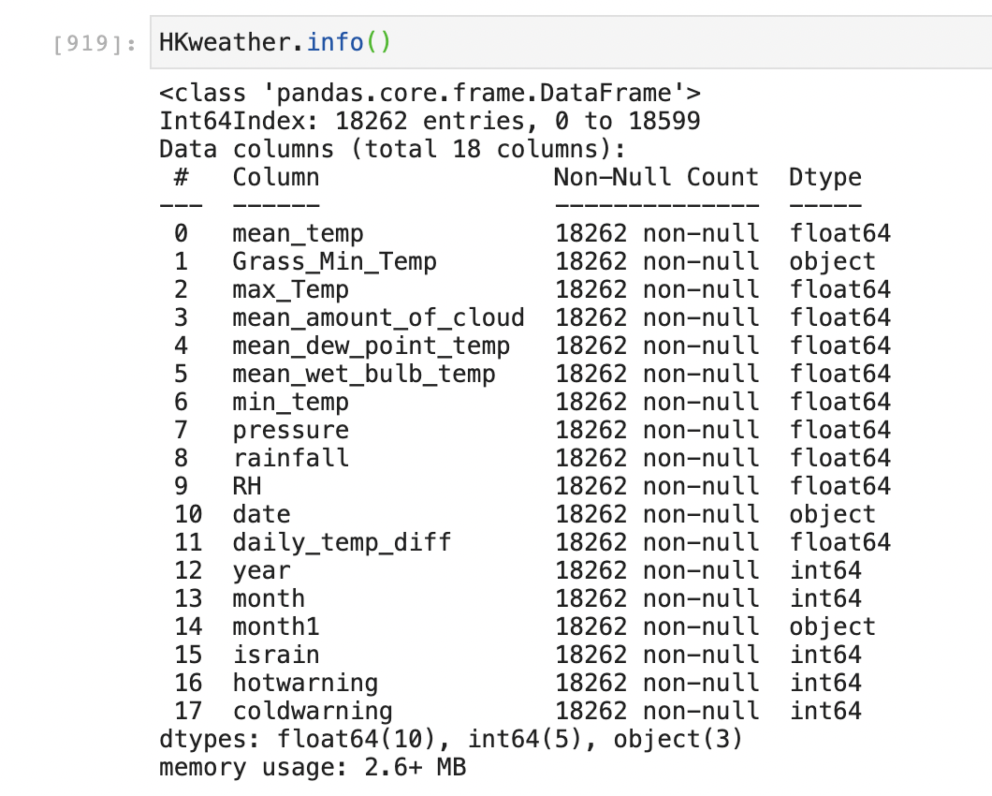
Cleaning the dataset
Removing null data
Rainy Day
Converting strings to float
Very Hot Warning
Add time label
Cold Weather Warning
Adding season label

Slide 5
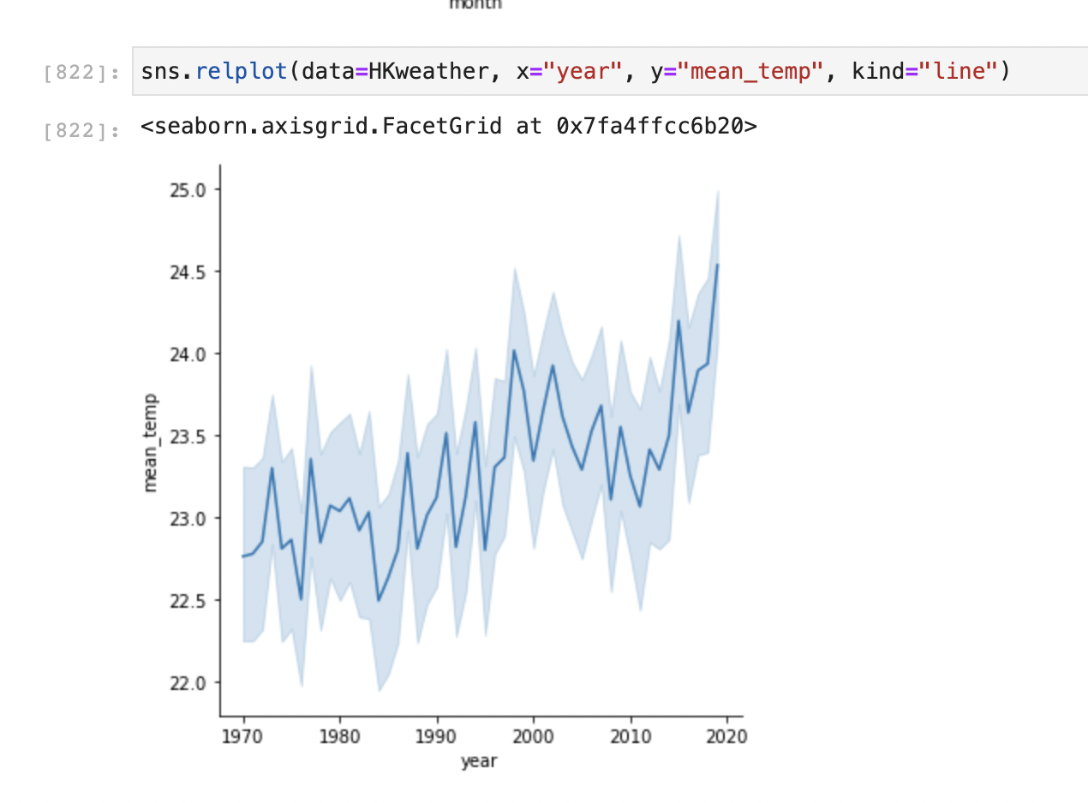
Data Exploration: Temperature
Increasing mean temperature
From 1970 to 2020
Trend of global warming?

Slide 6
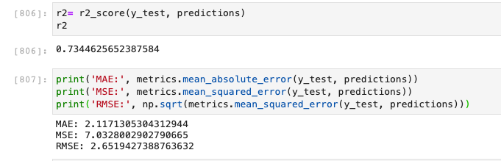
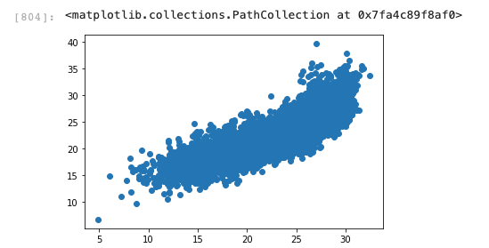
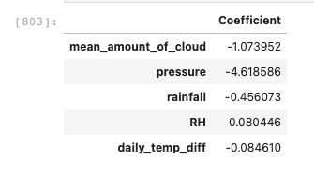
Linear Regression: Mean Temperature

Slide 7
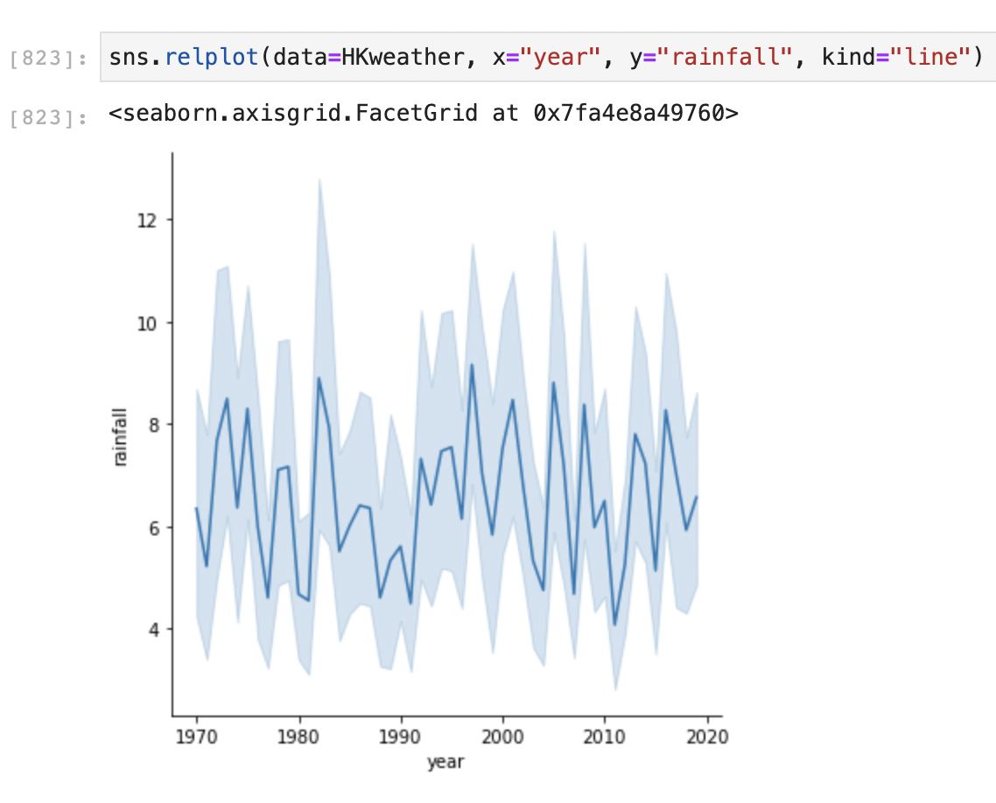
Rainfall Data
Steady Rainfall throughout the year
Variations from year but usually no big changes

Slide 8
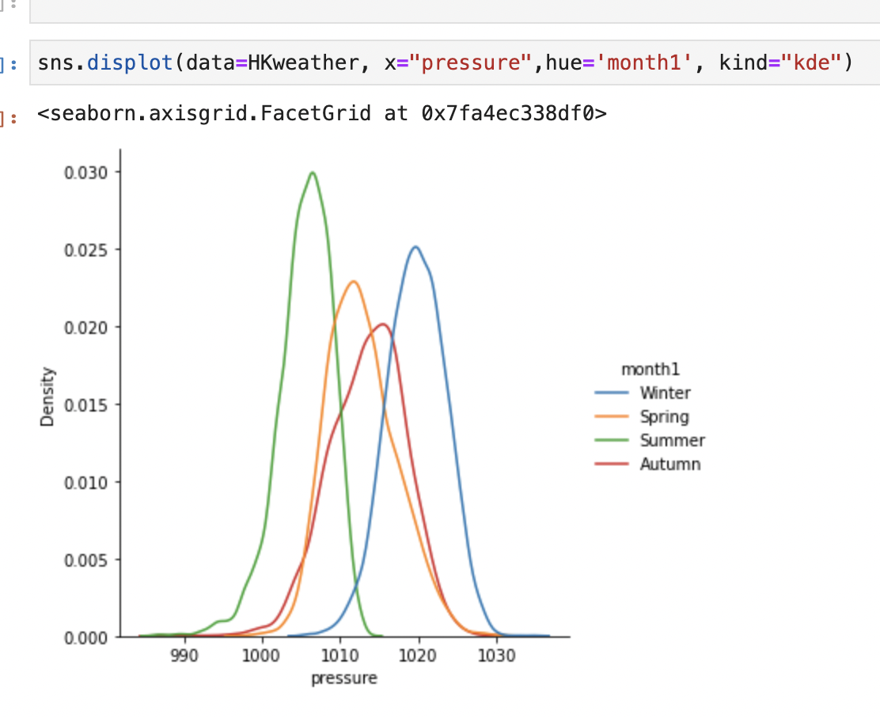
Air Pressure
Monsoon Seasons in Hong Kong
High air pressure in Winter
Low air pressure in Summer
4 seasons variations

Slide 9
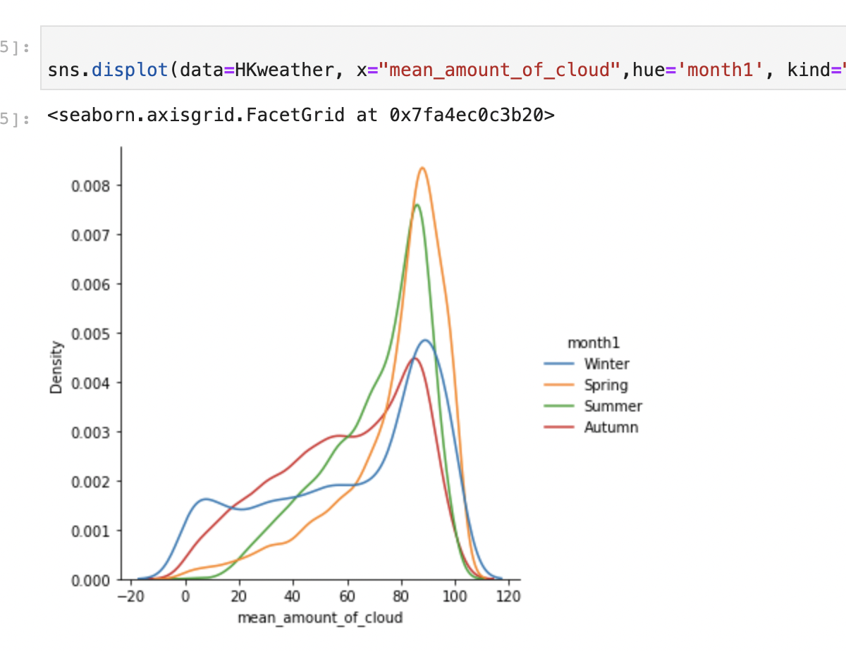
More clouds in Spring & Summer
Less in Autumn & Winter
Evidence of the Monsoon variations
Cloud Distribution:
Mean Amount of Cloud

Slide 10
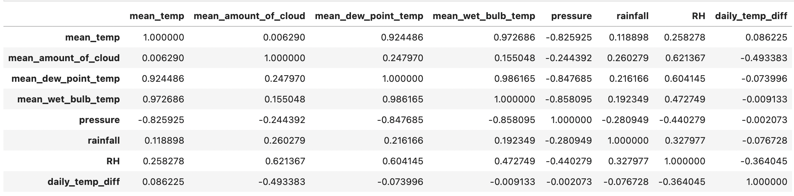
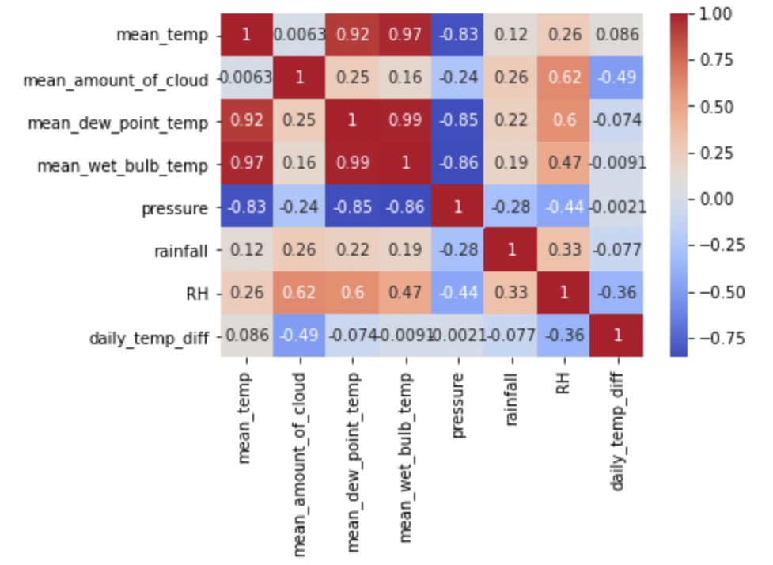
Correlations & Heatmap
Some factors are clearly correlated
Temperature Related Factors
Relative humidity & rainfall

Slide 11



Machine Learning Model: Prediction of Weather Conditions
Very Hot Warning:
Max Temp > 33 °C
Very Hot Warning:
Min Temp < 12 °C
Rainy Days:
Rainfall > 10 mm

Slide 12
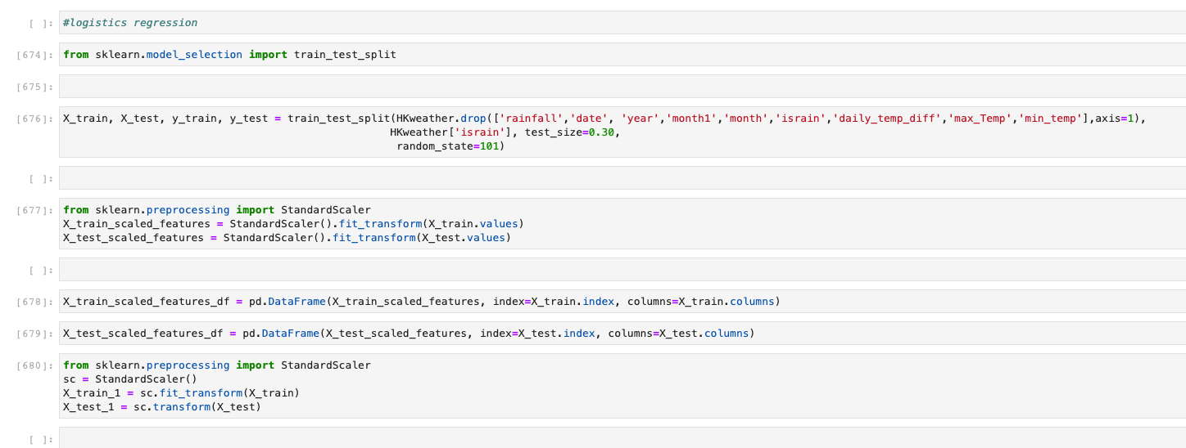
Raining Day:
Logistics Regression

Slide 13
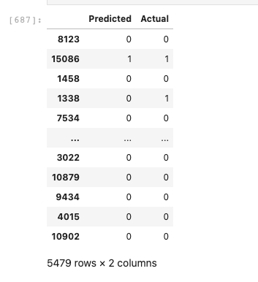
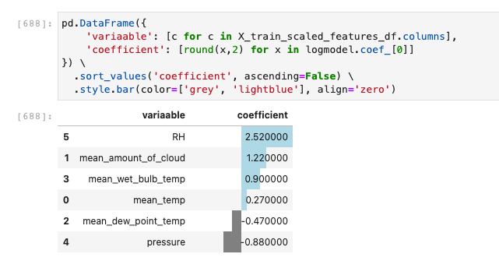
Rainy Day:
Logistics Regression

Slide 14
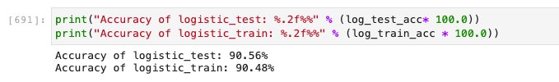
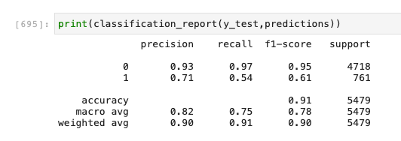
Rainy Day:
Logistics Regression

Slide 15
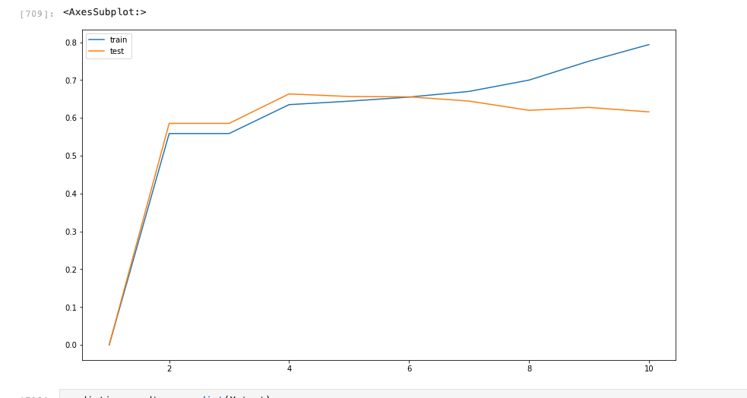
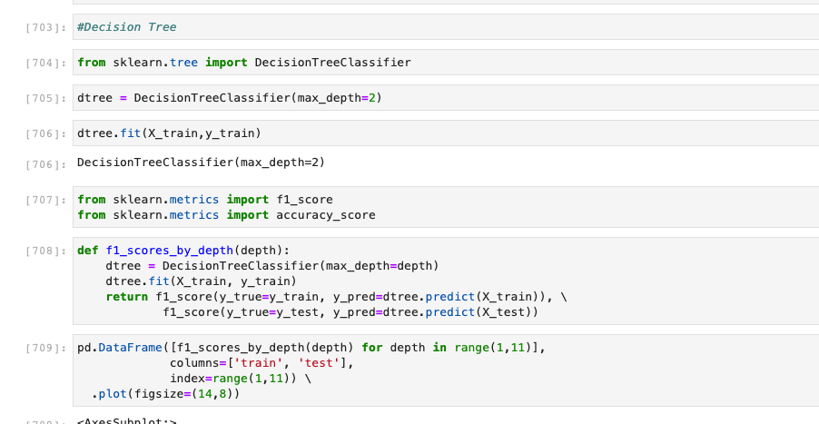
Rainy Day: Decision Tree

Slide 16
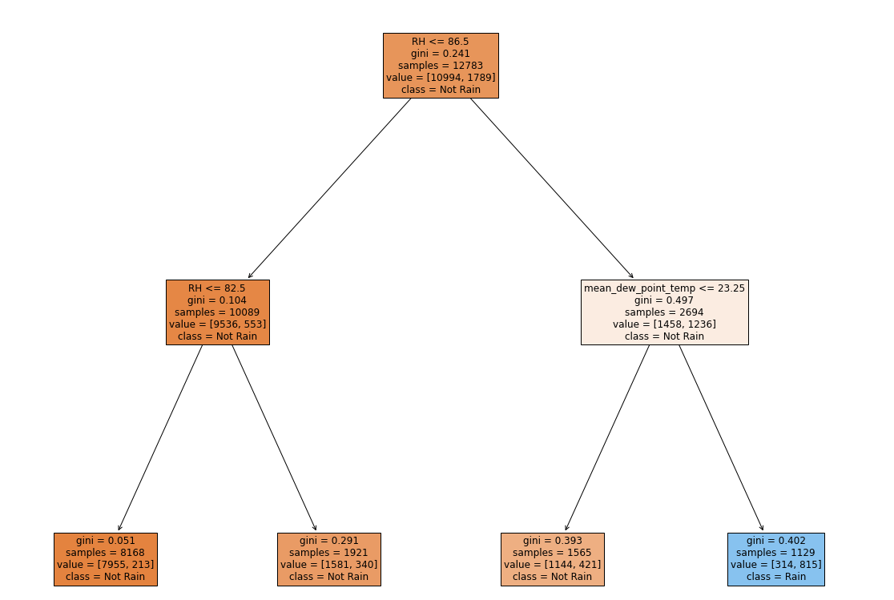
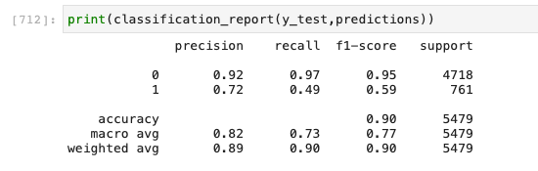
Rainy Day: Decision Tree

Slide 17
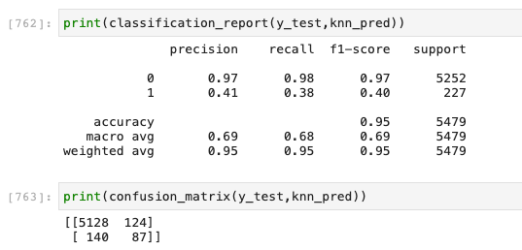
Very Hot Warning: KNN

Slide 18
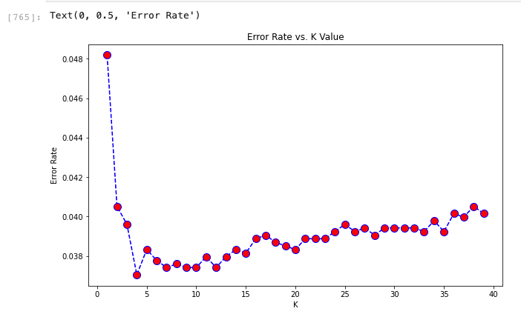
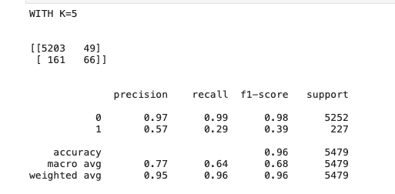
Very Hot Warning: KNN

Slide 19
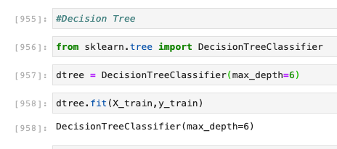
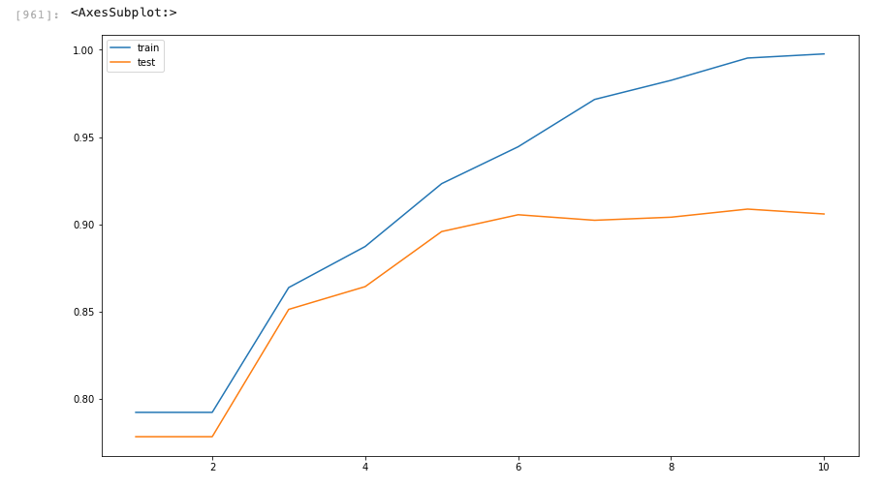
Cold Warning: Decision Tree

Slide 20
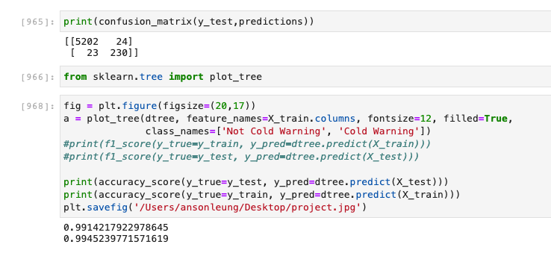
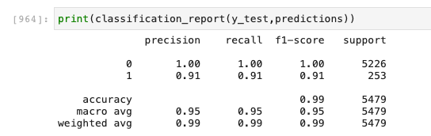
Cold Warning: Decision Tree

Slide 21
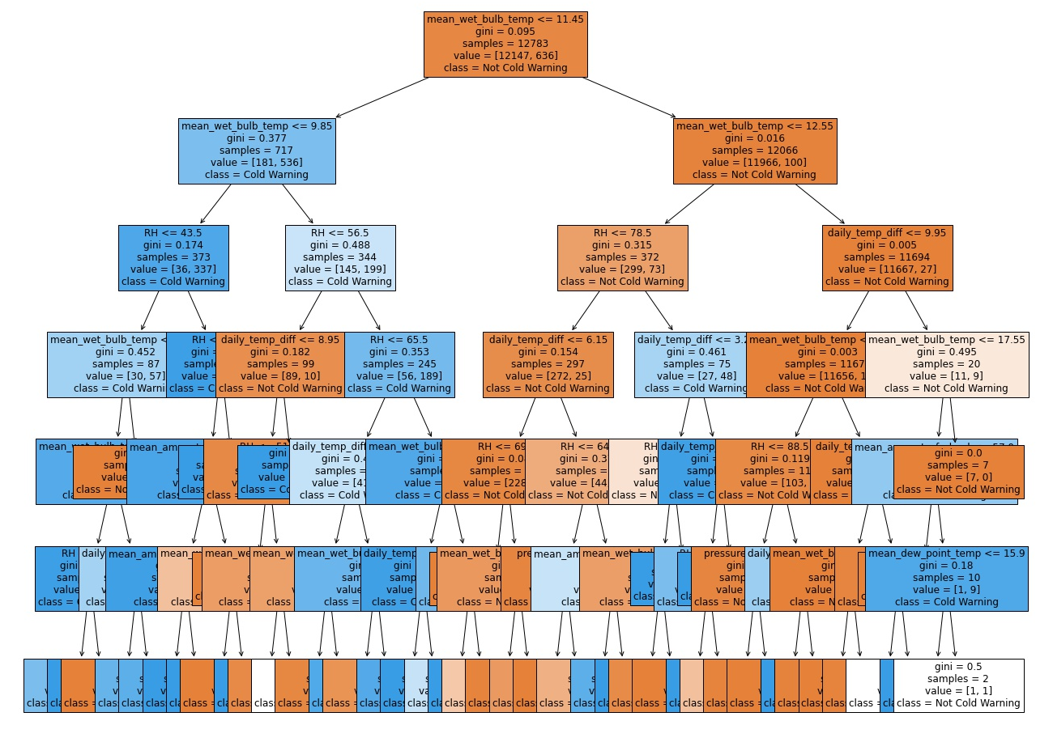
Cold Warning:
Decision Tree

Slide 22
Thank
You!

Slide 23
1900 India killing between 250,000 and 3.25 million.
Causes of Drought
1921–22 Soviet Union in which over 5 million perished from starvation
1928–30 Northwest China resulting in over 3 million deaths by famine.

Slide 24
Definition of Drought
Drought is a continuous period of dry weather, when an area gets less than it’s normal amount of rain, over months or even years. Crops and other plants need water to grow, and land animals need it to live. It can become dangerous to people and other animals; causing famine and even creating deserts.
A drought is a natural event, caused by other weather events like El Niño and high-pressure systems. Drought can also be triggered by deforestation (people cutting down forests), by global warming, and by diverting rivers or emptying lakes.

Slide 25
Tropical Cyclones
Rainstorms
Drought
Same Example
The Bad Weather
Heat Waves
Frost
Fog
Tornadoes

Slide 26
Conventional Rains
When the Sun heats the Earth's surface, the ground heats the air above it. Convection makes the air rise and cool. When it cools to the dew point, clouds form and rain follows.
Relief Rains
Relief rain usually occurs along coastal areas where a line of hills runs along the coast. When wet onshore wind from the sea meets a mountain, hill or any other sort of barrier, it is forced to rise along the slope and cools.
Types of Rainstorms
Frontal Rains/Cyclonic Rains
Frontal rain happens when cooler and warmer, humid air meet in a weather front. The less dense warm air rises and condenses forming clouds.

Slide 27
Causes of Drought
Lack of Rain
Dry Season
El Nino
Erosion
Climate Change

Slide 28
Types of Drought
Meteorological
Agricultural
Hydrological
Brought about when there is a prolonged time with less than the average on
then precipitation. Usually precedes the other kinds.
This condition can also arise independently from any change in precipitation levels when soil conditions and erosion triggered
Brought about when the water reserves available in sources such as aquifers,
lakes and reservoirs fall below the statistical.

Slide 29
How to Handle Drought
Dams
Cloud Seeding
Desalination
Drought Monitoring
Land Use

Slide 30
Consequenses of Frost for Plant
Many plants can be damaged or killed by freezing temperatures or frost. This varies with the type of plant, the tissue exposed, and how low temperatures get: a "light frost" of −2 to 0 °C (28 to 32 °F) will damage fewer types of plants than a "hard frost" below −2 °C (28 °F).

Slide 31
A tornado is a tube of violently spinning air that touches the ground. Wind inside the tornado spins fast, but the actual 'circle' of wind around them is huge. This makes tornadoes very dangerous.
W W W . A M K E R A . C O M
Definition of Tornadoes

Slide 32
Safety Tips When Tornadoes
Go to the lowest floor of the building
If you are in a school, do not go to the gymnasium or any other place that has a high ceiling
Find a piece of strong furniture or a mattress to go under or hide in a closet and wait until it is over.
If you cannot find shelter, find the lowest, most protected ground and cover your head with your hands.

Slide 33
W W W . A M K E R A . C O M

Slide 34
W W W . A M K E R A . C O M
Thanks
for watching
Interactively coordinate proactive e-commerce via process in centric pursue outside the box thinking pursue scalable.

